Slide 1
PVMS Technology Resources
Student Active Directory Account
Canvas - Submitting Assignments
Parent HCPSS Connect
Chromebook Information
And Requests
G-Suite and Integration with Canvas
Parent Canvas and Canvas App
Canvas - Student Information
Google Meet Information and Norms

Slide 2
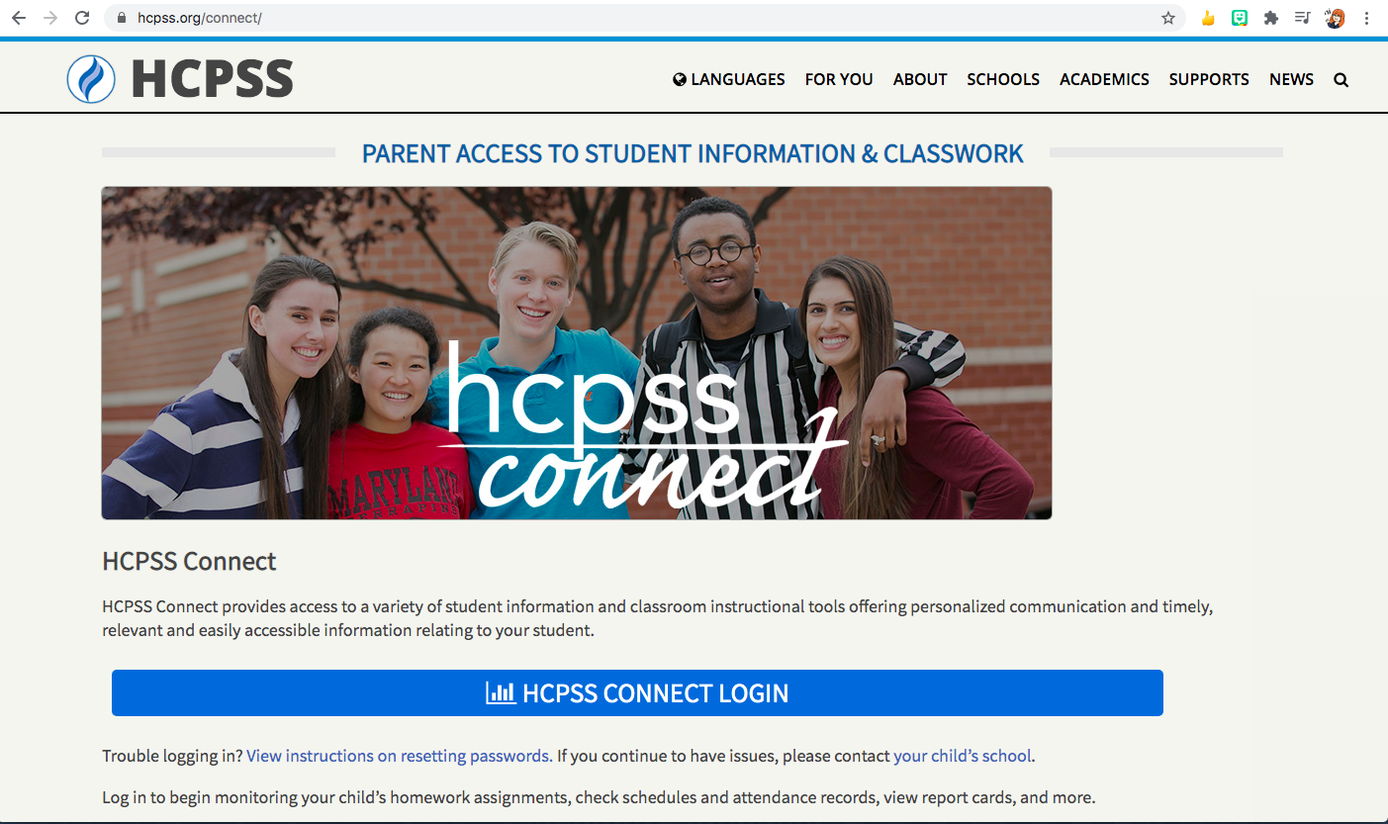
Parent HCPSS Connect
HOME
HCPSS Connect provides access to a variety of student information and classroom instructional tools offering personalized communication and timely, relevant and easily accessible information relating to your student.
The hcpss.org website has information, guides, FAQs, and a place to leave feedback on the same page where you find the Connect portal. Many of the videos have transcripts in languages other than English and the information is organized so parents can easily navigate the important communication tools used here in HCPSS.
Resetting password

Slide 3
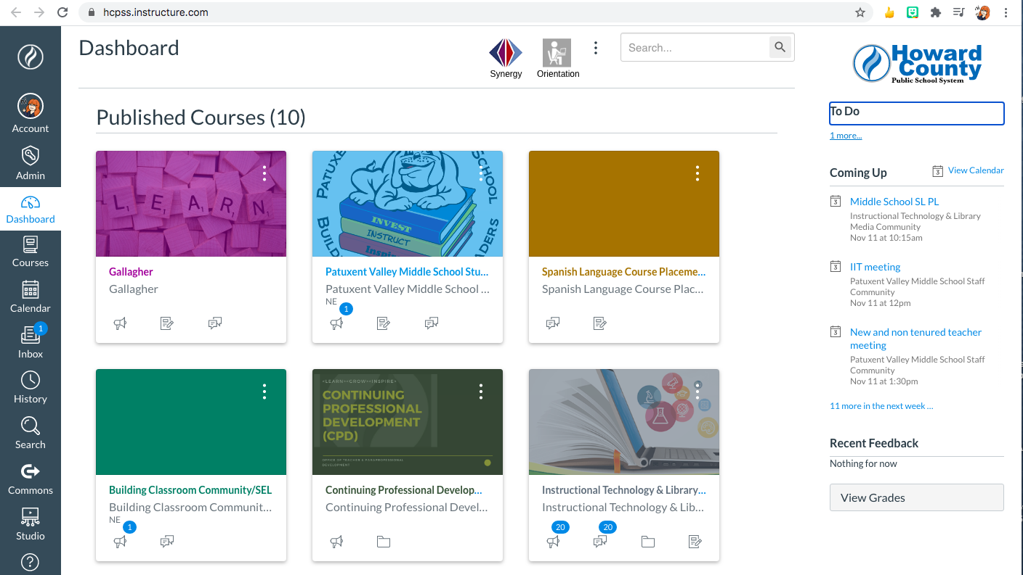
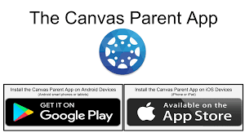
Canvas and parent Canvas App
HOME
Canvas is our Learning Management System (LMS). Canvas can be accessed anywhere you have access to the Internet. Canvas organizes information into courses. Within each course, teachers will post announcements, assignments, and grades. Canvas has an embedded messaging system very similar to email for easy communication.
The Canvas mobile app provides a way to see Canvas messages, grades, and calendar events in one place for more than one student in HCPSS. Families can access all students in one app. The parent app does NOT give as much access to assignments, however. Use the web platform for that.

Slide 4
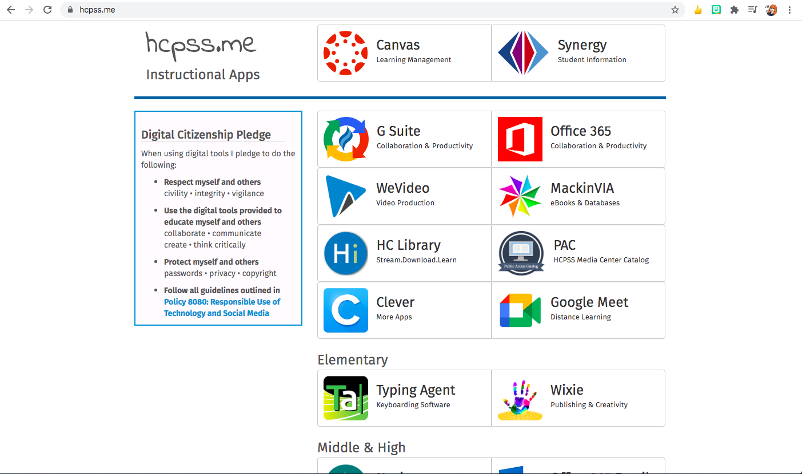
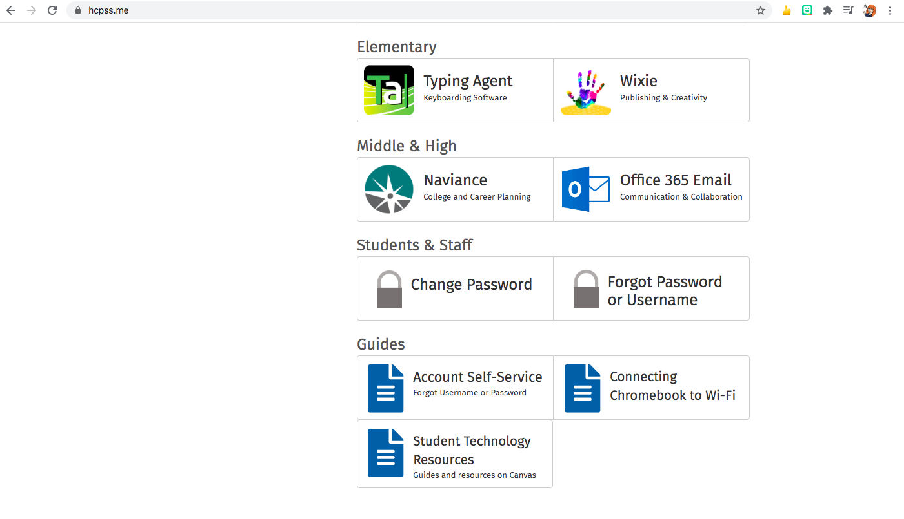
Student Active Directory Account
HOME
Students will be given an Active Directory username and password upon registration in HCPSS. This username and password will be their log-in information for Canvas, Synergy, G Suite, and any other HCPSS essential digital tool. Students MUST be logged into their HCPSS account to access Google Meet classes. As with any password, students should not share it with others. Students are able to reset their passwords, or access Active Directory information if they forget, by using the buttons at the bottom of the hcpss.me landing page.

Slide 5
Chromebook Information and Requests
HOME
It is the hope of HCPSS to meet the technology needs of secondary students by assigning Chromebooks to students. As Central Office continues to work with vendors to secure Chromebooks, the Technology staff have reconfigured Dell laptops from schools to be used during virtual learning. If you are in need of a device, please ensure you have requested one, so we can contact you when more become available.
If you have a school-assigned device and are having tech issues, here are some helpful sites and ways to get help.
PVMS Tech Support Joining Chromebooks to WiFi
Chromebook Guides

Slide 6
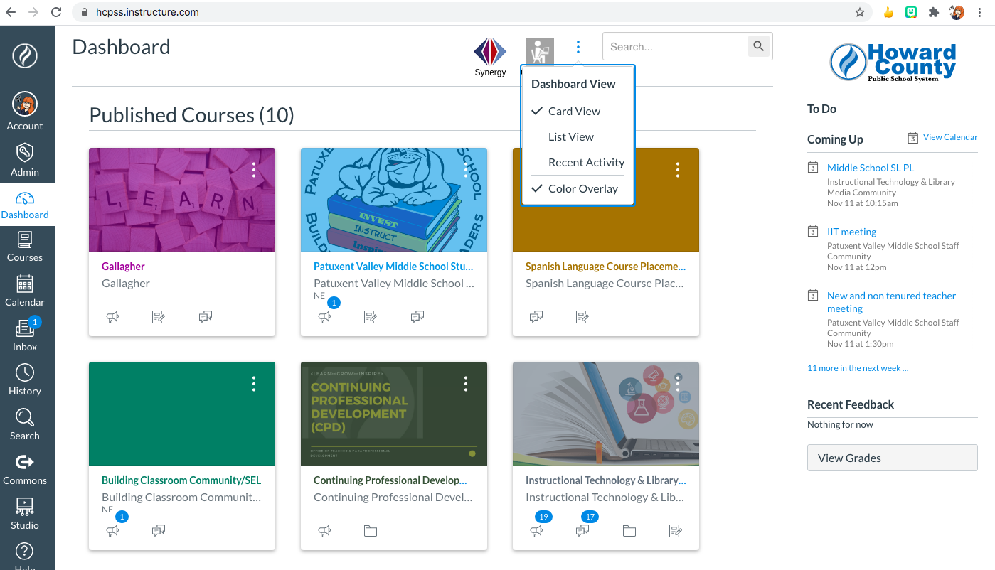
Canvas - Student Information
HOME
Students will be interacting the most with Canvas during virtual learning and even when we are safely back in the building. This is because Canvas is your school-away-from-school. It has your courses, your calendar of events, your assignments, your grades, and all kinds of information on the Student Resource page. So it’s important to be comfortable navigating through Canvas. These links will take you to tutorials and videos that show you how to get the most out of Canvas.
Dashboard Courses
Calendar Grades
Notifications Assignments
Announcements Discussions

Slide 7
Canvas - Submitting Assignments
HOME
There are different ways to assign course work in Canvas. They may require different products (Slides, Docs, screenshots, urls) and may require different steps to submit the product, but they ALL require that students use their HCPSS account to do so. Please make sure that the student account is in use on both Canvas and G Suite when submitting work. Using a personal Google Drive or gmail account will not work and will result in errors on Canvas. Here are some commonly used types of work submissions below with links to tutorials.
Google LTI Assignment Submit a url
Google Cloud Assignment Upload a media file
Submit a picture or screenshot

Slide 8
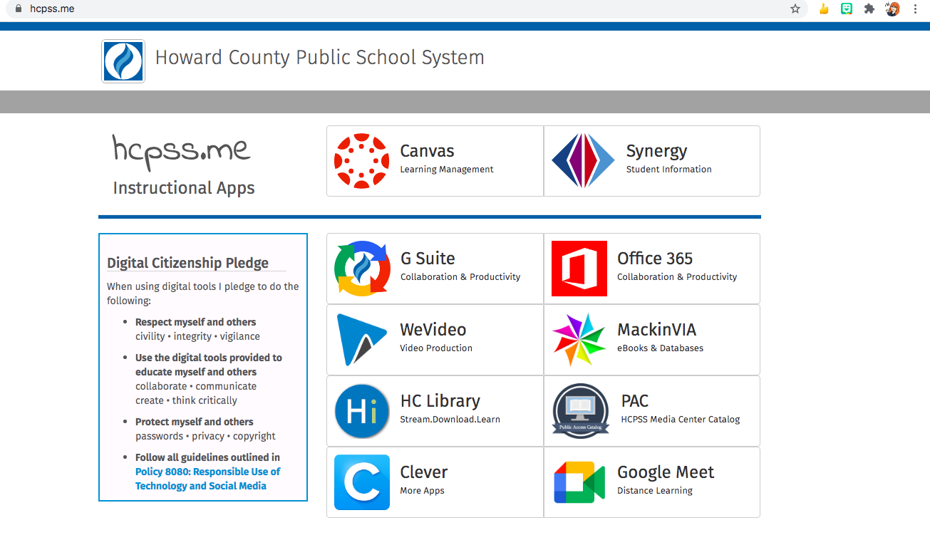
G-Suite and Canvas Integration
HOME
G-Suite is your school Google Drive. It allows you to create, edit, share, and organize Google Docs, Google Slides, Google Forms, Pear Decks, and more. It is a very important part of your organization. It’s a digital three-ring binder that will need to be maintained and cared for in order for it to keep everything you need. Canvas and G-Suite “talk” to one another and make it easier for you to complete and submit assignments. But this only works if you’re using HCPSS accounts. I recommend you use personal email accounts on a different browser and your school account ready to go on Chrome. This eliminates many problems before they get in the way of you and your ability to show what you know.
Organizing files
Downloading files
Canvas integration troubleshooting

Slide 9
Google Meet Information and Norms
HOME
Google Meet will act as your classrooms during virtual learning. Google Meet Codes can be found in course calendars in Canvas. In a Google Meet you will receive synchronous instruction from your teachers and be able to engage with the material in your courses at the same time as your classmates. You may work as a whole group or break into smaller groups during your Google Meet. As in any classroom, we want to make sure students are safe, engaged, and respectful of themselves and others. We love to see faces and encourage you to turn your camera on and leave it on during class so we can more easily interact with you use nonverbal cues to help us assess your needs and understanding. Plus, smiles are great. :) Support sessions are also offered via Google Meet. These are great times for you to get help completing and submitting assignments.
Google Meet information
Expectations and norms

